Slide 1
Leaf Segmentation Using the CNN
FINAL PRESENTATION (IMAGE PROCESSING 481)
-Goutham Selvakumar
-Hithesh Shanmugam

Slide 2
Introduction
The identification of plant species mainly depends on the recognition of plant leaf characteristics. However, most recognition systems show the weak performance on detecting small objects like plant leaves in the complicated background.
In recent years, evolutionary neural networks have attracted much attention of the researchers because of their ability to give superior image classification accuracy.
Advances in the processing of images provided various preprocessing techniques for the extraction of images. Feature extraction is the step taken to identify discriminatory characteristics that form the basis for classification. CNNs are well-suited for image classification tasks due to their close relationship between layers and spatial information, which explains their popularity in recent plant classifiers.

Slide 3
GOAL TO DO:
The goal of the project is to determine if adding the color to the leaf classification problem could prove beneficial.
Leaf classification is a popular topic amongst computer vison scientists. If we were able to identify plant species based on the images alone, it would allow a person without a background in botany to determine which species is what.
We will be using the Leaf snap dataset to provide clean lab images to work on.

Slide 4
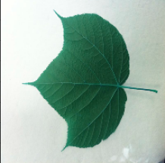
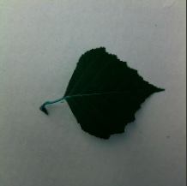
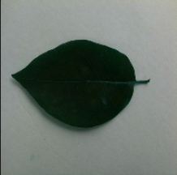
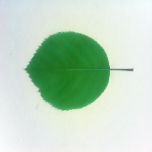
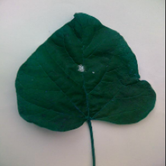
Implemented Methods
We took the dataset of ‘LeafSnap’ from kaggle which contained about 10,000 images of different tree species. 5 different tree species are shown as example.
Acer_Pensylvanicum(A) has 35 images, Betula_Populifolia(B) has 26 images, Disopyros_Virginiana(C) has 48 images, Amelanchier_laevis(D) has 31 images, and Catalpa_Speciosa (E) has 72 images.
A
B
C
D
E

Slide 5

1. Binary Segmentation
Binary Segmentation is carried out in order to get a binary image for leaves within the Dataset. Before the segmentation, we have to convert the images to grayscale so that the background could be easily identified from leaf images.
Generally, the white background should have a higher pixel value than the leaf images themselves. Furthermore, the background containing mostly white, after applying the mean thresholding to the image, the white pixels should be counted as the main value within the image due to their value and how prominent they are within the image itself and all the other pixels should be less than the mean.

Slide 6
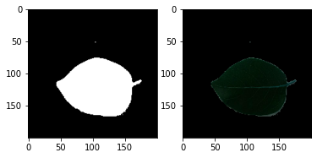
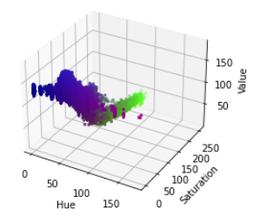
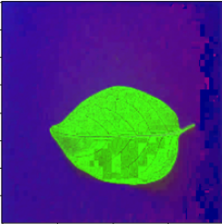
2. Color Segmentation:
To get the leaf images excluding the white background, color segmentation had to be performed on the dataset. The applied technique here was a manual calculation of HSV representing Hue, Saturation, and Value respectively for class of leaves.
Firstly, the image had to be converted from RGB space to the HSV space. After the conversion, a 3D grid was developed in order to map out the approximate values that each class of leaf will fall into, to visualize how the HSV values fall within the leaf image.
The second image depicts that the “green” hue values are falling between 40 and 90, saturation is falling between 105 to 255, and the values falling between 0 to 255. Furthermore, the best leaf was decided based on the clearest background of each set to find the values to use for thresholding.
We can see the purple pixels mixed in within the leaf ranges and makes it harder to capture the leaf as the background was changed into purple pixels.

Slide 7






Binary Segmentation:
Mostly the images are properly segmented using the automatic mean thresholding technique. As we can see from the results for the binary segmentation for each of the classes (shown only 5). Most of the leaf image was captured within the segmentation technique.
From the result, it is proven that the background was identified as the highest value within the images, so it turned to black, while the leaves had a lower value than the mean so they turned to white.
There are some images having more white pixels in the corner of a few images, but the entire leaf was captured so it would be an acceptable segmentation. But, not every leaf image was segmented correctly as in some instances there was leaf merging with the background.

Slide 8
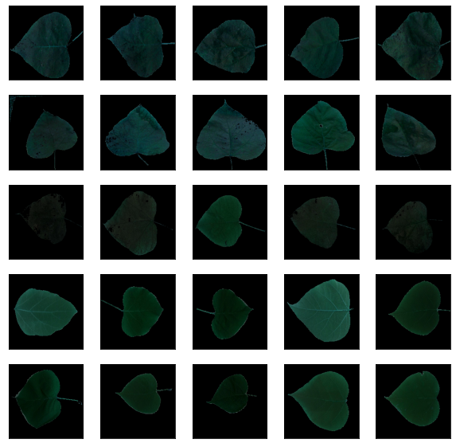
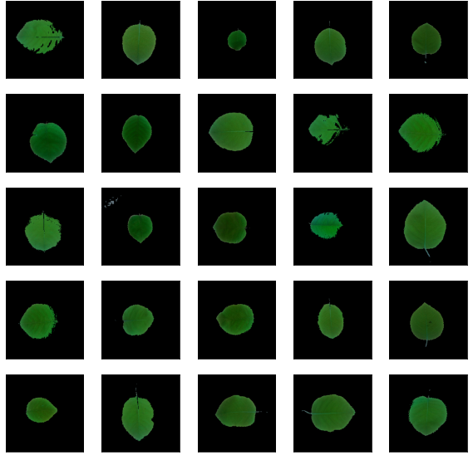
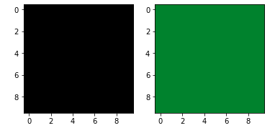
Color Segmentation:
Segmentation for colour turned out to be good with the HSV grid chart estimation method. All classes were segmented by the different shades of green present within the leaf image.
The HSV grid charts for these classes was important as these leaves tend to have brighter values which helped in the charting out of the HSV values for these leaves.
To avoid the purple background we used black and green masking for the difference.

Slide 9
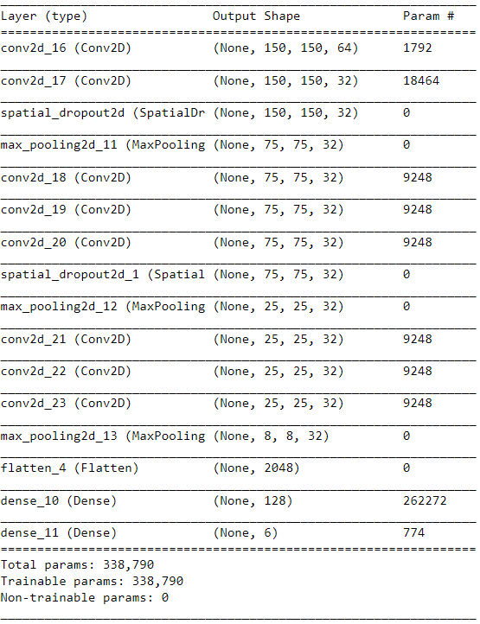
Convolutional Neural Network
Convolution neural network was used within this project as the classifier to check if the neural network could pick up on the image shape itself and identify the leaf species.
The model consisted of about 16 layers, with the total amount of parameters being 338,790.
It seems that the Neural Network, prevented it from being able to differentiate between different colors. The majority of classes hold approximately 100 and 150 examples, least is about 50 examples.

Slide 10
Model Architecture:
Architecture:
The model consists of 8 convolution layers 3 max pooling layer 2 spatial dropout 2D layers 1 flatten layer and 2 dense layers. In the first convolutional layer, there are 64 3x3 filters with padding and second convolution layer with 32 3x3 filters with padding the next is spatial dropout with 0.25 and the next is max pooling layer with 2 strides. This is repeated for another two times with an additional convolution layer but every convolution layers in the rest is 32 3x3 filters with padding.
Activation Features:
Rectified Linear Unit Activation Function is used in this network
Parameters:
Parameters are the values that are considered as the weights in the fully connected layers.
Dropout:
We did the dropout to reduce the overfitting to prevent the model from relying on high activations.

Slide 11
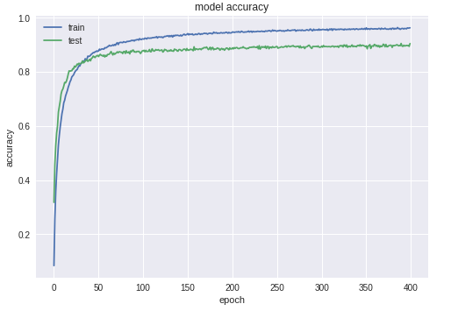
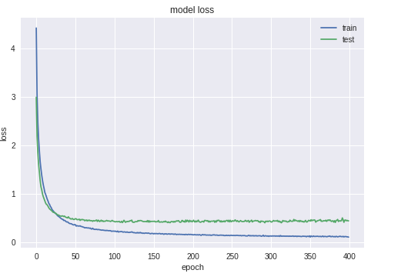
The test picture’s classes are predicted using our model and creating a data frames which holds these predictions together with all the relevant information's.
Basically, the use of CNN increased the performance of our model by 89% that was trained on an average of 133 examples per each of the 185 classes of the plant species. Furthermore, this shows us how promising the approach of CNN’s are for the image classification.

Slide 12
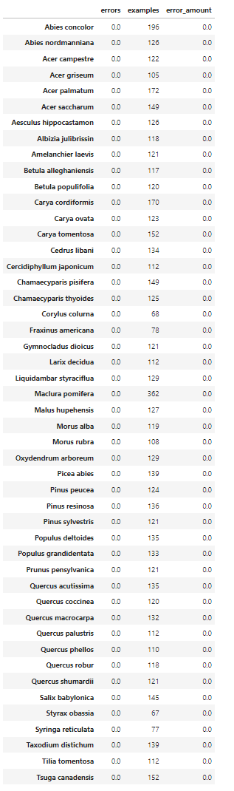
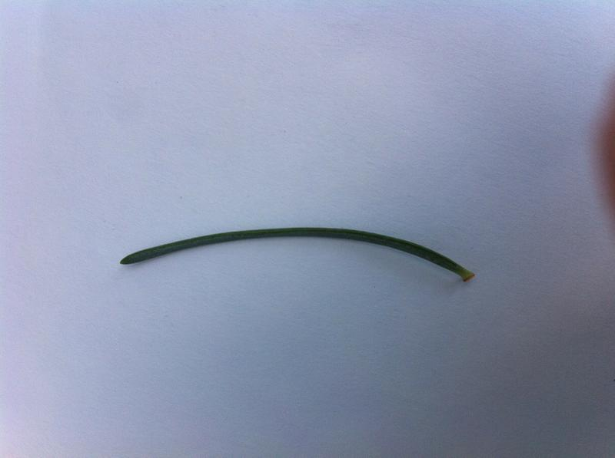
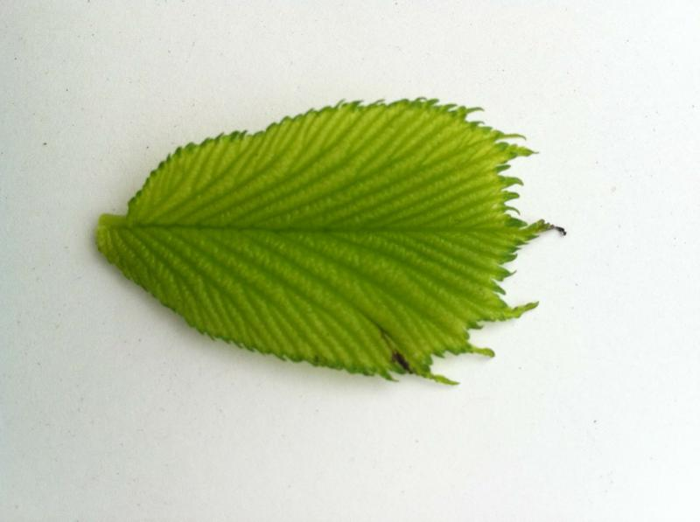

Most of the plant species were predicted with the color using the Convolutional Neural Network. Abies Concolor, Abies Nordamanniana, Acer Campestre, Acer griseum, and Acer palmatum, etc are example classes that has no errors while predicting. However, we faced an error (12) for the class of Ulmus glabra with 118 examples.
The figure (A) [“Abies Concolor”] can be shown as an example for plant species with the lowest error rate of 0 with 196 examples. At the same time, figure (B) [“Ulmus Glabra”] can be used for the highest error rate.
A
B

Slide 13
Conclusion:
Using a bigger dataset with better balanced and containing different species might be useful for the predictions.
Since, the picture versions have a higher resolution of 64x64 pixels that can be passed as input to the CNN in order to boost up the performance.
Furthermore, we were able to increase the performance for the plant species that were relatively smaller in size which were able to benefit from this approach.

Slide 14
THANK YOU

